Slide 1
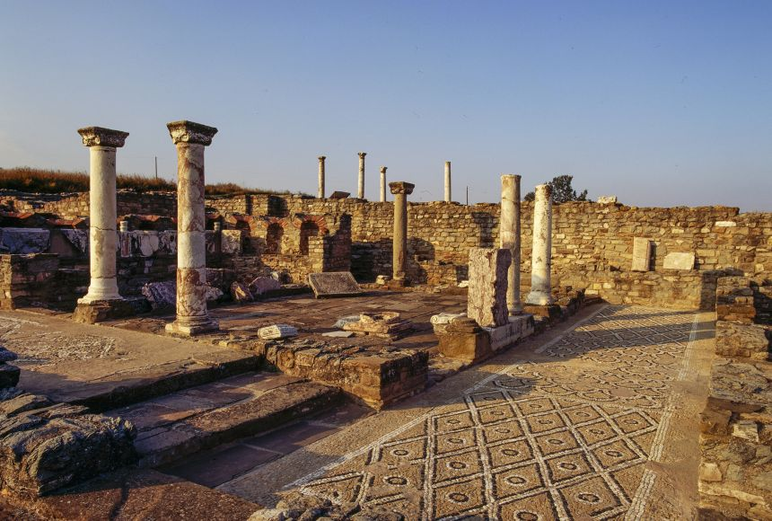
Ancient Macedonia Source Analysis and Review
Goal/s:
Discuss the features of Ancient Macedonia
Create a timeline of key events
Week 1 Lesson 3 – unit 2
Ms Barrie

Slide 2
ACTIVITY 1 – Values and Beliefs
Read through the information sheet ‘Values and Beliefs’
Highlight key words
Summarise key words in your book

Slide 3

ACTIVITY 2 – Timeline of key events
Using the key dates provided, create a timeline of key events.

Slide 5
ACTIVITY 3 – Source Analysis
Analyse the sources about Ancient Macedonia. Answer the following questions about each source:
What is the FOCUS of this source? (what person, event, or idea is it about?)
What is the MESSAGE of this source? (What is it trying to teach you about the person, event, idea?)
Is the source useful as historical evidence? Give evidence why/why not?

Slide 6
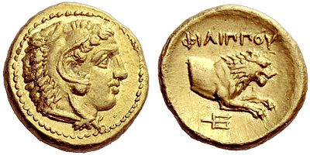
SOURCE 1
What is the FOCUS of this source? (what person, event, or idea is it about?)
What is the MESSAGE of this source? (What is it trying to teach you about the person, event, idea?)
Is the source useful as historical evidence? Give evidence why/why not?
A gold half stater of Philip II of Macedon produced at the government mint of Pella, bearing the head of a young Heracles wearing the Nemean Lion’s Skin on the obverse and on the reverse the lion's forepart

Slide 7
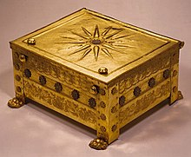
SOURCE 2
What is the FOCUS of this source? (what person, event, or idea is it about?)
What is the MESSAGE of this source? (What is it trying to teach you about the person, event, idea?)
Is the source useful as historical evidence? Give evidence why/why not?
The Vergina Sun, the 16-ray star covering the royal burial Larnax of Philip II of Macedon (r. 359 – 336 BCE), discovered in the tomb of Vergina, formerly ancient Aigai
Notes:
A larnax (plural: larnakes; Ancient Greek: λάρναξ, lárnaks, plural: λάρνακες, lárnakes) is a type of small closed coffin, box or "ash-chest" often used in the Minoan civilization and in Ancient Greece as a container for human remains—either a corpse (bent back on itself) or cremated ashes.

Slide 8

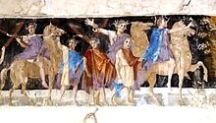
SOURCE 3
What is the FOCUS of this source? (what person, event, or idea is it about?)
What is the MESSAGE of this source? (What is it trying to teach you about the person, event, idea?)
Is the source useful as historical evidence? Give evidence why/why not?
An ancient fresco of Macedonian soldiers from the tomb of Agios Athanasios, Thessaloniki, Greece, 4th century BC

